Slide 1
A Microsoft Mobil Alkalmazásfejlesztési Platform
Érsek Attila
Twitter: @ersekattila

Slide 2

17
Azure adatközpont régió
Azure
Régiók
Notes:
Speaking Points:
Windows Azure itself is deployed around the world
With Windows Azure, we have a concept of regions, which is where you choose to place your code and run.
In each of the regions, we have a Microsoft datacenter.
These datacenters are massive facilities that host 10s or in some cases hundreds of thousands of servers
We have currently four regions in North America, two regions in Europe, and two in Aisa
As you can see on this slide we also have a number of CDN edge points, which we can use to cache your content and deliver it even faster for customers. %
What you’re going to see in the next couple months and years is that we will rapidly expand our datacenter footprint around the world, so you will have more options for running your applications.
Once you build an application, you can choose where you want to run in the world and you can move your workloads from region to region.
You can also run your application in multiple regions simultaneously and just direct traffic and customers to whichever version of the app is closest to them.
That gives you a global footprint and a chance to reach a bigger customer base or audience in new markets
Notes:
Windows Azure services such as compute and storage are now available in 8 worldwide datacenters with an additional 24 Content Delivery Network endpoints.
You can’t have a real cloud without a data center.

Slide 3



Windows Azure
Rugalmas
Nyitott
Stabil
Notes:
Slide Objectives:
Provide a high level summary of Windows Azure and what it enables at a high level
Speaking Points:
Transition:
Several of you are probably asking, just what is Windows Azure?
Definition:
From a high level, Windows Azure is Microsoft’s Cloud Computing platform.
It’s designed to enable you to build, deploy, and scale your applications in the cloud.
Over the last year, we’ve been focused on three core tenants with Windows Azure – which you will see reflected throughout this keynote.
Flexible
The first is to make it Windows Azure really flexible and able to handle pretty much any workload on top of it.
When we introduced Windows Azure a few years ago, we pioneered the concept of Platform as a Service, by providing a set of scalable, managed services that you can advantage of as a developer [to compose applications]
We continue to push that forward with a bunch of great features that you will see in a few minutes
This past year we have also enabled a concept called infrastructure as a service, which is the ability to host and scale durable virtual machines in the cloud as well.
With Windows Azure’s support for infrastructure as a service, you can install Windows or Linux and more easily migrate existing applications and workloads.
This combination of the ability to run both platform as a service and infrastructure as a service together ends up being a really powerful combination and makes Windows Azure super flexible.
Open
We also focused a lot this year on making Windows Azure even more open.
With Windows Azure you can use your choice of operating systems, your choice of frameworks, and your choice of tools.
This really opens up the most possibilities in terms of building on the platform
Another aspect of this openness is to use open protocols whenever possible.
For example, we use the memcachD protocol for our Caching service, we now support the AMQP protocol for our Service Bus messaging service, and all of the managed services are exposed through simple REST-based APIs that can be called from any framework or language.
This enables you to interoperate very easily with our services and integrate with what you already have
We’ve also taken all of our SDKs for Windows Azure and released them under an Apache 2 open source license and hosted them on GitHub.
Solid
Lastly, we’ve focused a lot during the last year on making Windows Azure a really solid platform. One that you can bet your business on and that you know will be reliable.
Built in across the platform is support for redundancy and across our managed services we provide guaranteed SLAs that you can bet on and know that your applications will scale and scale reliably.
Summary
We believe the end result is truly a unique model
You can now use both platform as a service and infrastructure as a service *together*
You can now use the best of the Microsoft ecosystem and the best of the open source ecosystem *together*
Enabling you to build better and more scalable solutions.
Notes:
Comprehensive set of services that enable you to build, host and scale applications in Microsoft datacenters
Windows Azure is an open and flexible cloud platform that enables you to quickly build, deploy and manage applications across a global network of Microsoft-managed datacenters. You can build applications using any language, tool or framework. And you can integrate your public cloud applications with your existing IT environment.

Slide 4



Windows Azure
Saját Adatközpont
Virtual Machines
Cloud Services
Web Sites
Alkalmazás
Alkalmazás
Alkalmazás
Alkalmazás
Adat
Adat
Adat
Adat
Tűzfal
Tűzfal
Tűzfal
Hálózat
Hálózat
Hálózat
O/S
O/S
Virtualizáció
Hardware
Fókusz az alkalmazáson
Notes:
Slide Objectives:
Explain the differences between traditional self-hosting and the three options of Windows Azure hosting.
Notes:
In a traditional environment you must manage the full stack. With Windows Azure you can choose a variety of options depending on your needs.

Slide 5


Mobile-first
Cloud-first

Slide 6

A Mobil jelenleg a legnagyobb technológiai innováció a világon
Notes:
Note to wirestone: We can use an illustration here if we have time. We can use a landscape representing how mobile devices are shaping the world (people talking on the phones, using tablets, cars connected to the cloud, etc.)
Mobile devices are now at the center of the technology ecosystem, and even enterprise developers who have historically written client-server applications are rapidly shifting to embrace this reality. Developers building customer-facing apps need to reach the breadth of devices that exist in the consumer market, and developers building internal-facing business applications are being asked to target the same breadth of personal devices that employees bring into the workplace.

Slide 7
10X
Nagyobb mint a PC boom a 80-as években
2X
Gyorsabb a 90-es évek Internet boom-jánál
3X
Gyorsabb mint a jelenlegi közösségi média terjedés
Notes:
¹ http://blog.flurry.com/bid/88867/iOS-and-Android-Adoption-Explodes-Internationally
² https://intelligence.businessinsider.com/smartphones-outpacing-pcs-two-to-one-2012-11
³ http://www.slideshare.net/kleinerperkins/kpcb-internet-trends-2013

Slide 8
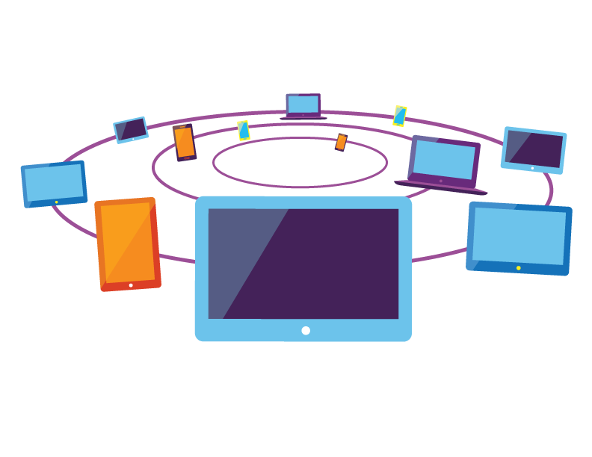
Az eszköz változatosság az új norma
Notes:
Note to wirestone: Please replace with a picture or full screen illustration that shows the concept of multiple devices and form factors (tablet, PCs, phones, wearables…).

Slide 9
A mobil stratégia dilemmája
Eszköz és platform specifikus alkalmazás
Felhasználói élmény
+
Gyors megjelenés univerzális alkalmazással
-
+
Jobb TCO és fejlesztői produktivitás

Slide 10

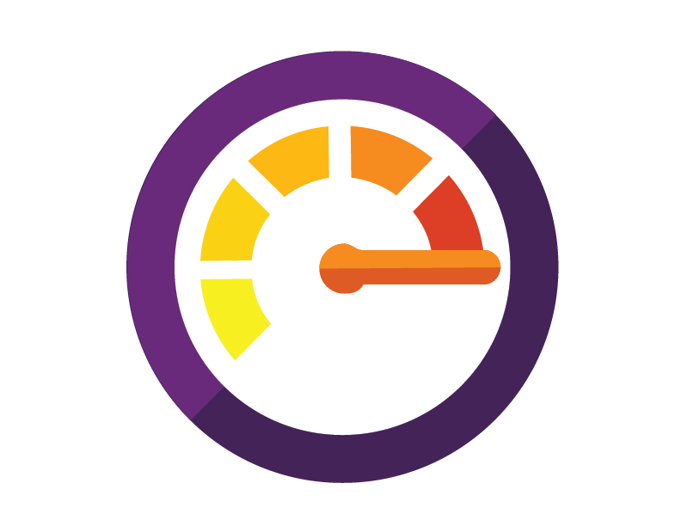


Hogyan tud a Microsoft segíteni?
Mobil élmény létrehozása
…az üzlethez kapcsolódva…
…a mobil korszak agilitásával.
Új mobil alkalmazások vagy meglévő alkalmazások mobil felülete Windows, iOS and Android eszközökön.
Akár nagyvállalati felhasználásra is alkalmas platform mely tökéletesen integrálódik a meglévő megoldásokhoz.
Hatékony és gyors alkalmazásfejlesztés a folyamatos kihelyezés, felügyelet és nyomonkövetés segítségével
Visual Studio
Microsoft Azure
Notes:
Note to wirestone: Please think of three illustrations to represent every pillar, we can then use that for every section that goes into the detail.

Slide 11
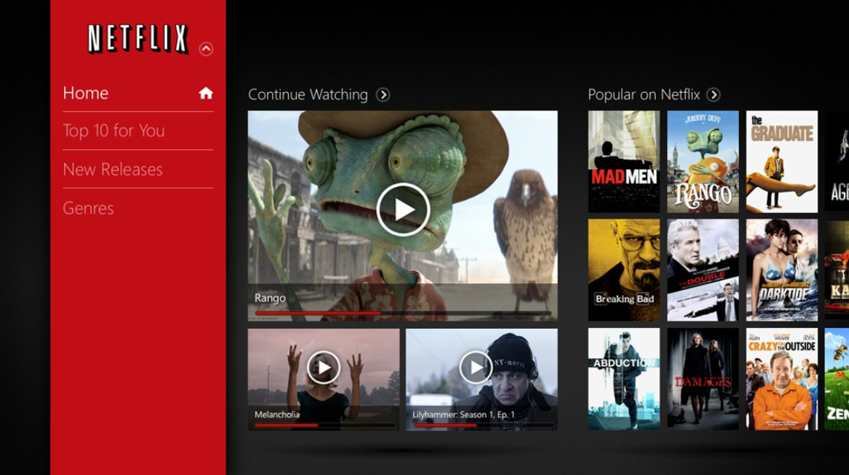
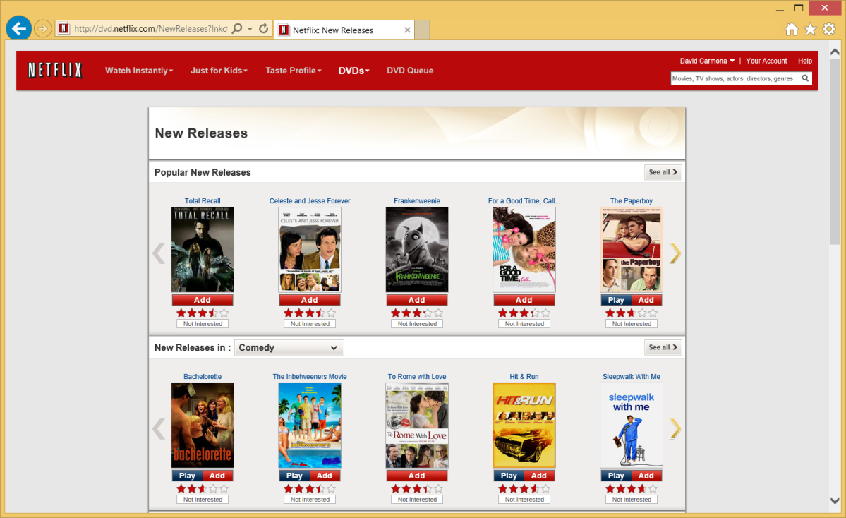


Eltérő megközelítési módok
Native
Web
Notes:
Key goal of slide
Slide Talk track
Transition

Slide 12
Eltérő megközelítési módok
Native
Web
Eszköz optimalizált élmény
Könnyű mozgathatóság
Produktív fejlesztői készletek
Frissíthetőség
Notes:
Note to wirestone: This slide needs work in the visualization, it’s ugly now.
Device optimized experience: Access to any API, performance, full customization per device, use of native controls, etc.

Slide 13





A Microsoft a választás szabadságát támogatja
.NET
Desktop apps
Universal Windows apps
Gazdag felhasználói élmény
Eszközök széles skálája
Böngésző alapú megoldások
HTML
Notes:
Key goal of slide
Slide Talk track
Transition

Slide 14


Native app development
Visual Studio and .NET
Most productive and powerful platform to create native applications for Windows
Create or modernize desktop applications and extend to new form factors
Universal Windows apps maximize code re-usage
z
Native UI
Native UI
Native UI
C# + XIB
C# + AXML
C# + XAML
+ Xamarin
Shared
client app C# logic
Reach iOS and Android devices with all the power and productivity of Visual Studio and .NET
Share app logic code across device platforms
Native performance for full customized experiences
100% APIs exposed, everything you can do in xCode, ADT you can do it with Visual Studio

Slide 15
Web app for devices
Web development with Visual Studio
CSS | HTML
JavaScript | TypeScript
Powerful IDE for HTML5 / CSS3
Highly interactive JavaScript-based apps
Suited for LOB browser-based apps
Black Box
+ Integrated hybrid app support
Hybrid app build-in support with Cordova
Full developer workflow for coding, debugging and instrumenting device hybrid apps
Visual Studio productivity for Android, iOS and Windows devices
Notes:
[2min]
This preview adds new project templates and tools for you to target the Apache Cordova project within Visual Studio. It is built on top the existing great HTML, CSS and JavaScript tooling in Visual Studio, but it integrates it with Apache Cordova, so you have things like intellisense support for the Cordova API, build for any targeted platform such as Android and directly from Visual Studio, run and debug the app on a device emulator or a remote device.
The cool thing about these tools is that you will naturally know how to use it if you are familiar with web development. It supports TypeScript, which is very handy for these applications that can get very complex. It also supports the most popular JavaScript frameworks that you are probably using already for your mobile web applications such as Angular, JQuery Mobile or Backbone.
Now you have the option to choose the multi-device strategy that is better for you:
Native development with .NET
Hybrid development with HTML and CSS

Slide 16
App services
ON-PREMISES
APPLICATIONS
MICROSOFT AZURE
DEVICES
Notification Hubs
Biztalk services
Data services
Networking services
Compute
Active Directory integration
Hybrid infrastructure
Powerful services
Flexible app models
Notes:
Note to wirestone: this slide needs a lot of design work,

Slide 17
MULTI-DEVICE DEVELOPMENT
Flexible app models
RICH EXPERIENCES
Powerful services
BREADTH OF DEVICES
Native development extended to any device
Hybrid infrastructure
Web development tailored to device apps
Agile
Planning
Monitoring
CLOUD SERVICES
Develop
Test
Release
MICROSOFT
AZURE
ON-PREMISES
APPLICATIONS
DEVELOPER TOOLS AND SERVICES
Notes:
Key goal of slide
Slide Talk track
Transition

Slide 18
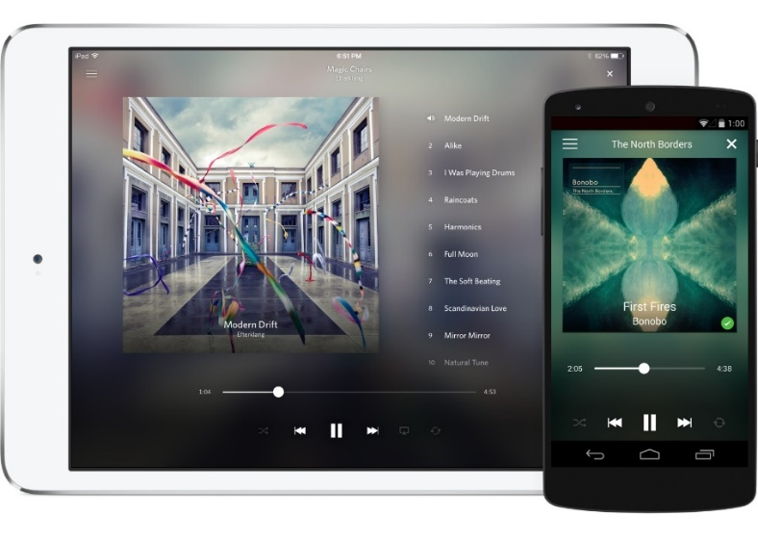
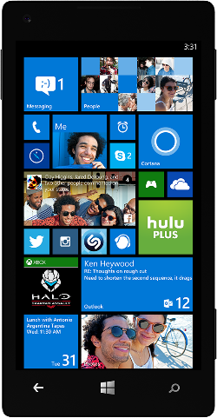

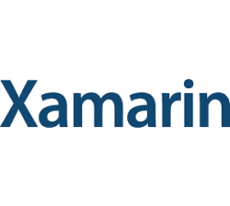



Slide 19
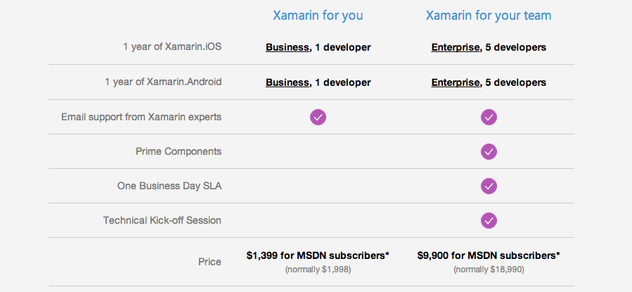
Xamarin előnyök MSDN előfizetőknek
Special pricing for individuals and teams
Extended trial
90-day trial of Xamarin for Visual Studio.
Exclusive Training
Learn the fundamentals of iOS, Android and cross-platform mobile development at your own pace with exclusive training content.

Slide 20
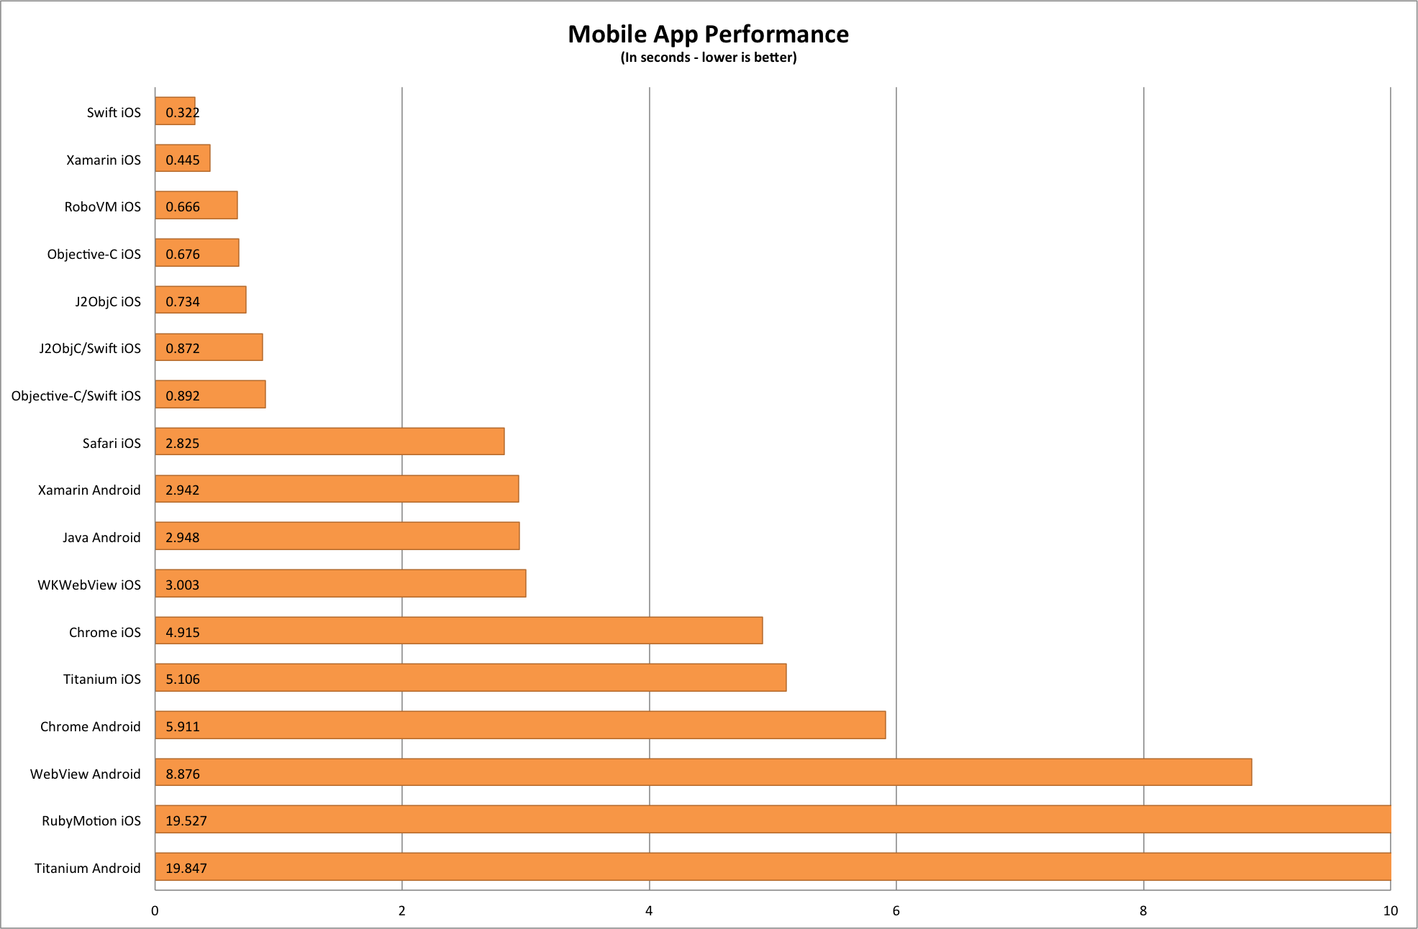
https://medium.com/@harrycheung/mobile-app-performance-redux-e512be94f976

Slide 21
Kérdések?
Notes:
Key goal of slide
Slide Talk track
Transition

Slide 22

Windows Azure Web Sites
Kész weboldalak pillanatok alatt
start simple
code smart
go live
Indulj ingyen, skálázódj ahogy szükséges.
Publikáld az website-od pár kattintással!
Klasszikus ASP vagy ASP.NET? Esteleg PHP vagy Node.js? Nem probléma, fejlessz akár Windows, Linux vagy OSX környezetben!
Felügyeld a teljesítményt, diagnosztizáld és javítsd a hibákat. Mindezt egyszerűen!
Notes:
Use ASP.NET, ASP, PHP, or Node.js
SQL Azure or MySQL databases
Start with open source apps and frameworks (LAMP)
Develop with VS and WebMatrix
Supports any Web development tool on any platform (Windows, OSX, Linux)
Rapid deployment for quick iteration
Integrated source control with Team Foundation Server (TFS) and Git
Built-in monitoring of perf and usage data, Application Insights
Quick access to request logs, failed requests diagnostics and diagnostics

Slide 23




Támogatott technológiák
Or any custom FastCGI Handler
Notes:
Slide Objectives:
Explain that Windows Azure Web Sites supports Classic ASP, ASP.NET, PHP, and Node.js out of the box and that you can also host any custom FastCGI handler.
Notes:

Slide 24
Demo
WebSites alapok
Notes:
Demo: Getting Started
Go to the portal
Create a new mobile service (Node backend works with most of deck)
Walk through Getting started screen
Choose platform
Download quick start
Run quick start
Save and update data
Show data in portal (Node)
Walk through client code that deals with Mobile Service

Slide 25



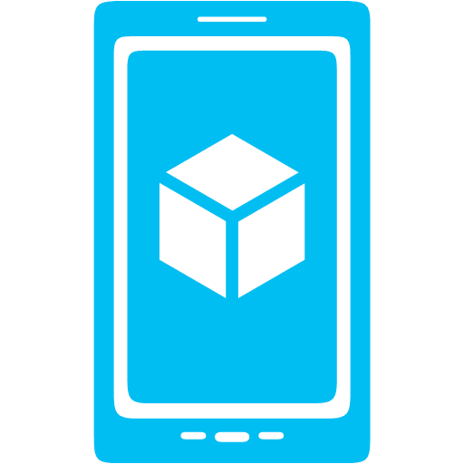



What is Mobile Services?
Storage
Authentication
Logic
Push
Scheduler
Notes:
Speaking Notes
Azure Mobile Services is a Backend-as-a-Service
Instead of you having to design, build, test, deploy, manage, and upgrade your whole backend, we do it for you
Features of Mobile Services
Storage – SQL DB
Authentication – built in support for social providers w/ ability to custom auth
Backend logic – data validation, logical flows, etc
Push Notifications – across all major mobile platforms
Scheduler – backend job processing

Slide 27
Demo
API
Scheduler
Source control
Logging
Scaling
Notes:
Demo: Getting Started
Go to the portal
Create a new mobile service (Node backend works with most of deck)
Walk through Getting started screen
Choose platform
Download quick start
Run quick start
Save and update data
Show data in portal (Node)
Walk through client code that deals with Mobile Service

Slide 28
Scheduler
Notes:
Speaking notes
Subject change: Scheduler

Slide 29
Scheduled Jobs
Executes a script on defined schedule
Can be run on demand
Ideal for any backend data processing job
Length / frequency based of Mobile Service tier
Microsoft Azure
Notes:
Speaking points
Schedule jobs (scripts) can be run by the scheduler
Ideal for any backend job processing (regular push notification, remove old data, etc)
Length and how often you can run job based off tier of your mobile service

Slide 30
Script Source Control
Notes:
Speaking points
Subject change: Script source control

Slide 31
Script Source Control
Creates a Git repo in Azure
Node.js only, turned on by default
Access table, scheduler, custom API, shared scripts and permissions
Pushing changes triggers a redeploy of your Mobile Service
Enables installing NPM modules (for Node backends)
Shared Scripts
Create scripts that can be used from all other scripts in your Service
Microsoft Azure
Notes:
Speaking points
Script source control creates GIT repo for all scripts and permission JSON files
Enables you to pull scripts down and edit locally
Lets you create shared scripts to reuse code
Enables installing of NPM modules (Node)

Slide 32
Diagnostics Logging Scale
Notes:
Speaking points
Subject change: diagnostics, logging, scale

Slide 33
Diagnostics, Logging, Scale
API Calls, # of Devices, Data Out
Console Logging (auto error logging)
Scale Service Based off API Calls
Auto-scale to Save Money
Free Tier for Mobile
Free Tier for SQL
Notes:
Speaking points
Some default stats like # of api calls, # of devices connecting, amount of data out
Api calls are important because that’s how mobile services’ scale is baed
All console statements and errors go to logging area
Auto-scaling helps save money
Free tier for Mobile Services and SQL while developing

Slide 34
Mobile Service Scaling
→ Free: 500k calls / month / subscription
→ Basic: 1.5M calls / unit (6) / month
→ Standard: 15M calls / unit (10) / month
Microsoft Azure
Notes:
Speaking points
Scaling
Free 500k / month / sub (across entire subscription is important distinction)
Basic 1.5M / unit / month (up to 6 units)
Standard 15M / unit / month (up to 10 units)
More units available by contacting support

Slide 35
Demo: Scaling
Leaving Free Mode and Turning on AutoScale
Notes:
Demo: Scaling
Go to scaling tab
Go to Standard mode
Turn on auto-scaling
Explain that additional units will only be turned on / used if you need them based off daily API calls

